Slide 1

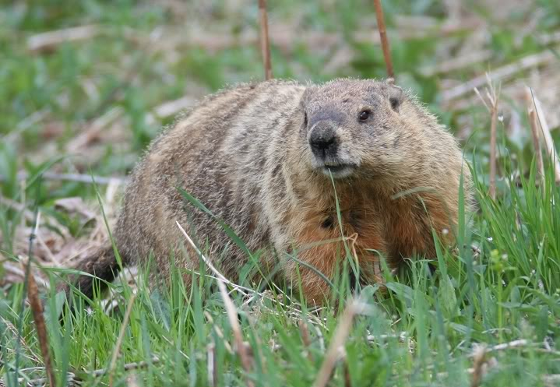
Salty Groundhogs
Ryan Stavella, Rosemary Bulgarelli, Philip Hasse, Alex Millet, Nick Schwartz, Kevin Lynch

Slide 2
Project Status
Accomplishments
Homework 3
Wireframe Mockups
Database
Tables Created
ER Diagram revised
Blockers
Activities being worked
HTML & CSS
Database
Backend Functionality

Slide 3
Decision Required
Status Report - Salty Groundhogs
9/26/2016
RGY | Item | Description | Mitigation / Help needed
Red
Green | ER Diagram | Revised comments on initial ER Diagram
Green | Database | Creation and Implementation of Database
Green | Wireframe Mockups | Designing the UI for the HTML web interface
Green | HTML | Creation of the UI

Slide 4
Project Schedule
Week 1 | Week 2 | Week 3 | Week 4 | Week 5 | Week 6 | Week 7 | Week 8 | Week 9 | Week 10 | Week 11 | Week 12 | Week 13 | Week 14 | Week 15
Gather Requirements
 |  | Use Cases/ UML |  |  | Final UML
 |  | Create Data Dictionary |  | Database
 |  | Create Github
 |  | ER Diagram
 |  | IT Requirements
 |  |  |  |  | HTML
 |  |  | Wireframe
 |  |  |  | TBD with more project info
 |  |  |  |  | PHP
 |  |  |  |  | APIs

Slide 5
Project Risks
Risk | Score | Mitigation
Customer data could be lost due to security vulnerability | High | Ensure latest fixes are installed Monitor open source community Extensive testing
Failure to connect to server | Low | Go to server lecture
DB creation and implementation | Low | normalization
SQL injection | Mid | Sanitizing SQL
SSH Connectivity | Low | Contacting System Admins

Slide 6
Project issues
Issue | Owner | Action Plan | Checkpoint Date
SSH Connectivity | IT | Contact System Admins | 9/21/2016 Resolved on 9/20/2016
Draw.io | CS | Dealt with it | 9/25/2016 Resolved on 9/26/2016

Slide 7
Lessons Learned
Lessons Learned | Corrective Action / Recommendation
Keep VM awake | Power on the VM

Slide 8
Communication Matrix
Stakeholder Name | Title | Information Required | Timing / Frequency | Delivery Method | Owner
True Course | Owner | Life Coach Application | Beginning Middle End | PDF/ Pablo | Pablo Rivas
Pablo Rivas | Intermediary Project Director | Progress Reports | Weekly | PDF via Github In class/ In person Email Phone | Kevin, Alex
Salty Groundhogs | Project Team | User Requirements/ Feedback IT Requirements/ Feedback | Multiple Times Per Week | Email Slack | Kevin, Alex
Marist Professors | SME | Project Problems | As needed | Email Office Hours Class | All
Dan and Jimmy | System Administrators | VM Problems | As needed | Text In Person | Kevin, Ryan

Slide 9
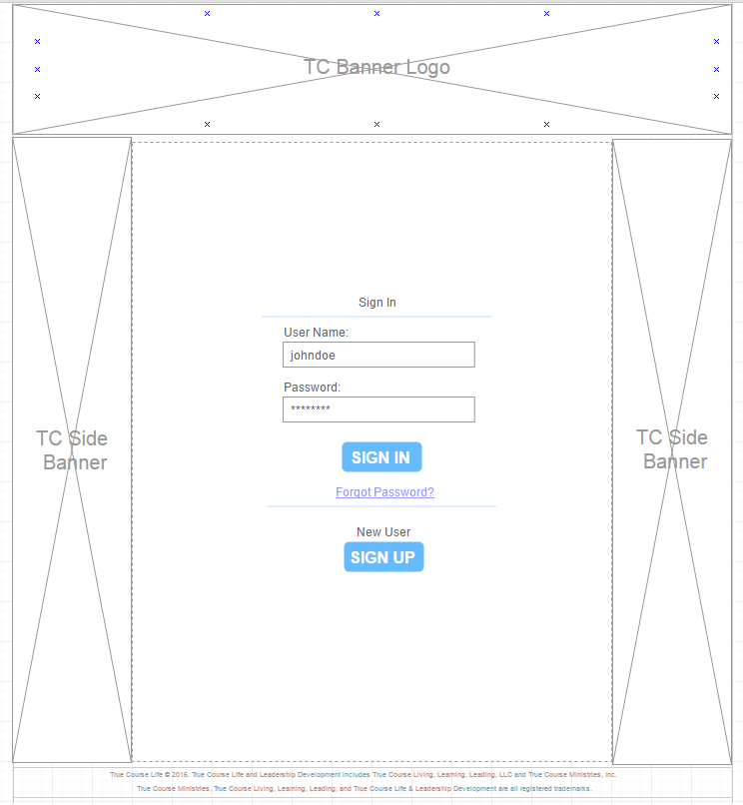
Login

Slide 10
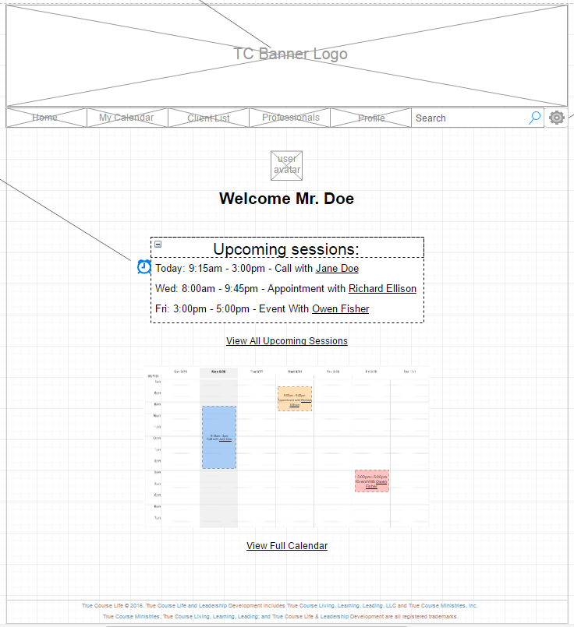
Homepage

Slide 11
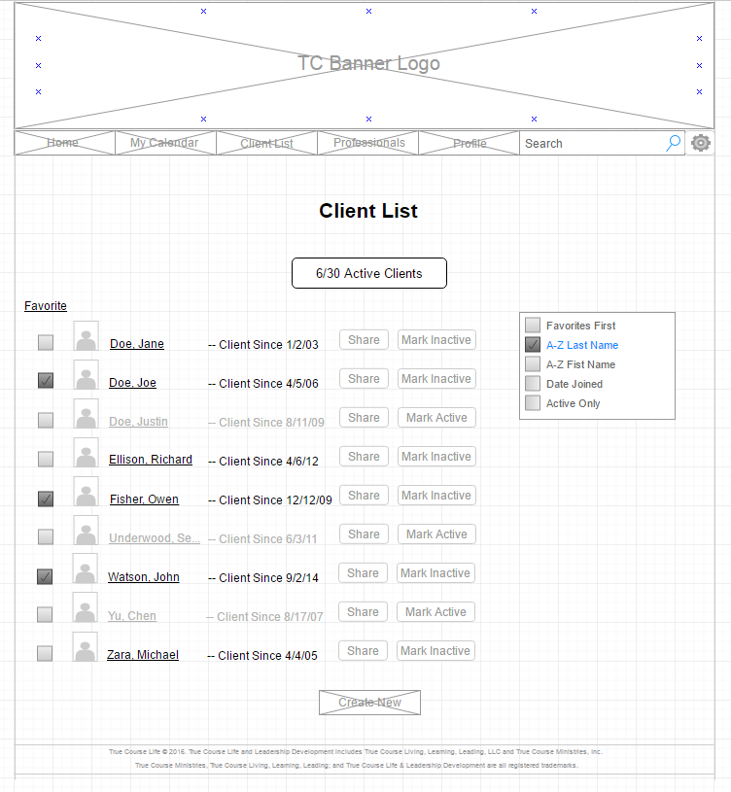
Client List

Slide 12
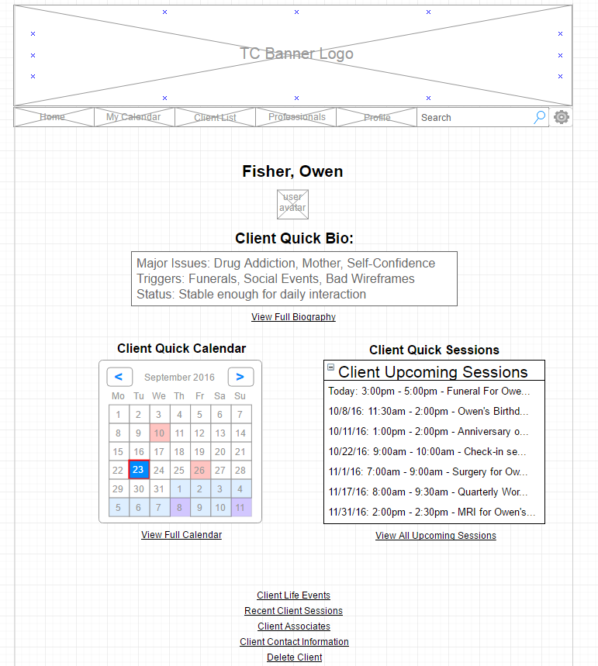
Client page

Slide 13
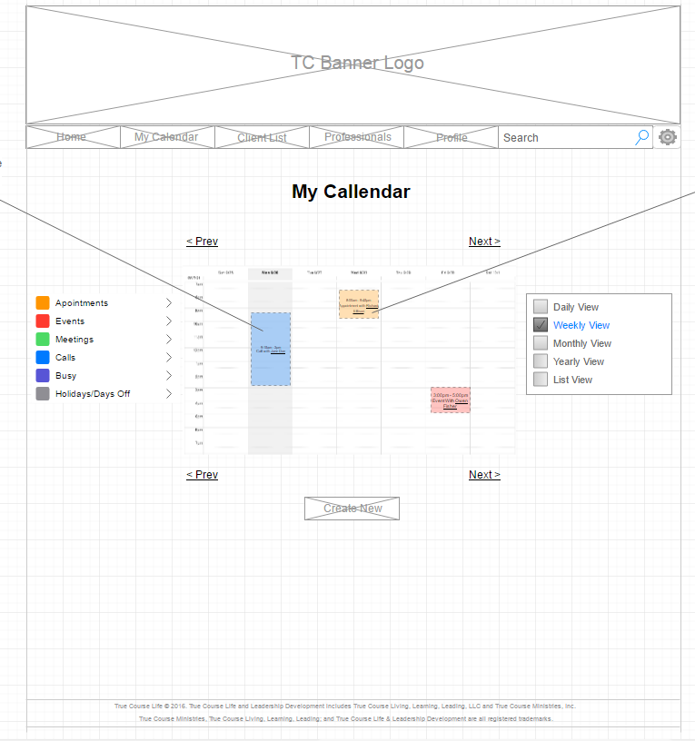
Calendar

